Slide 1

Online Teaching Stress Analysis
Linta Mariya Joy
Msccs216

Slide 2
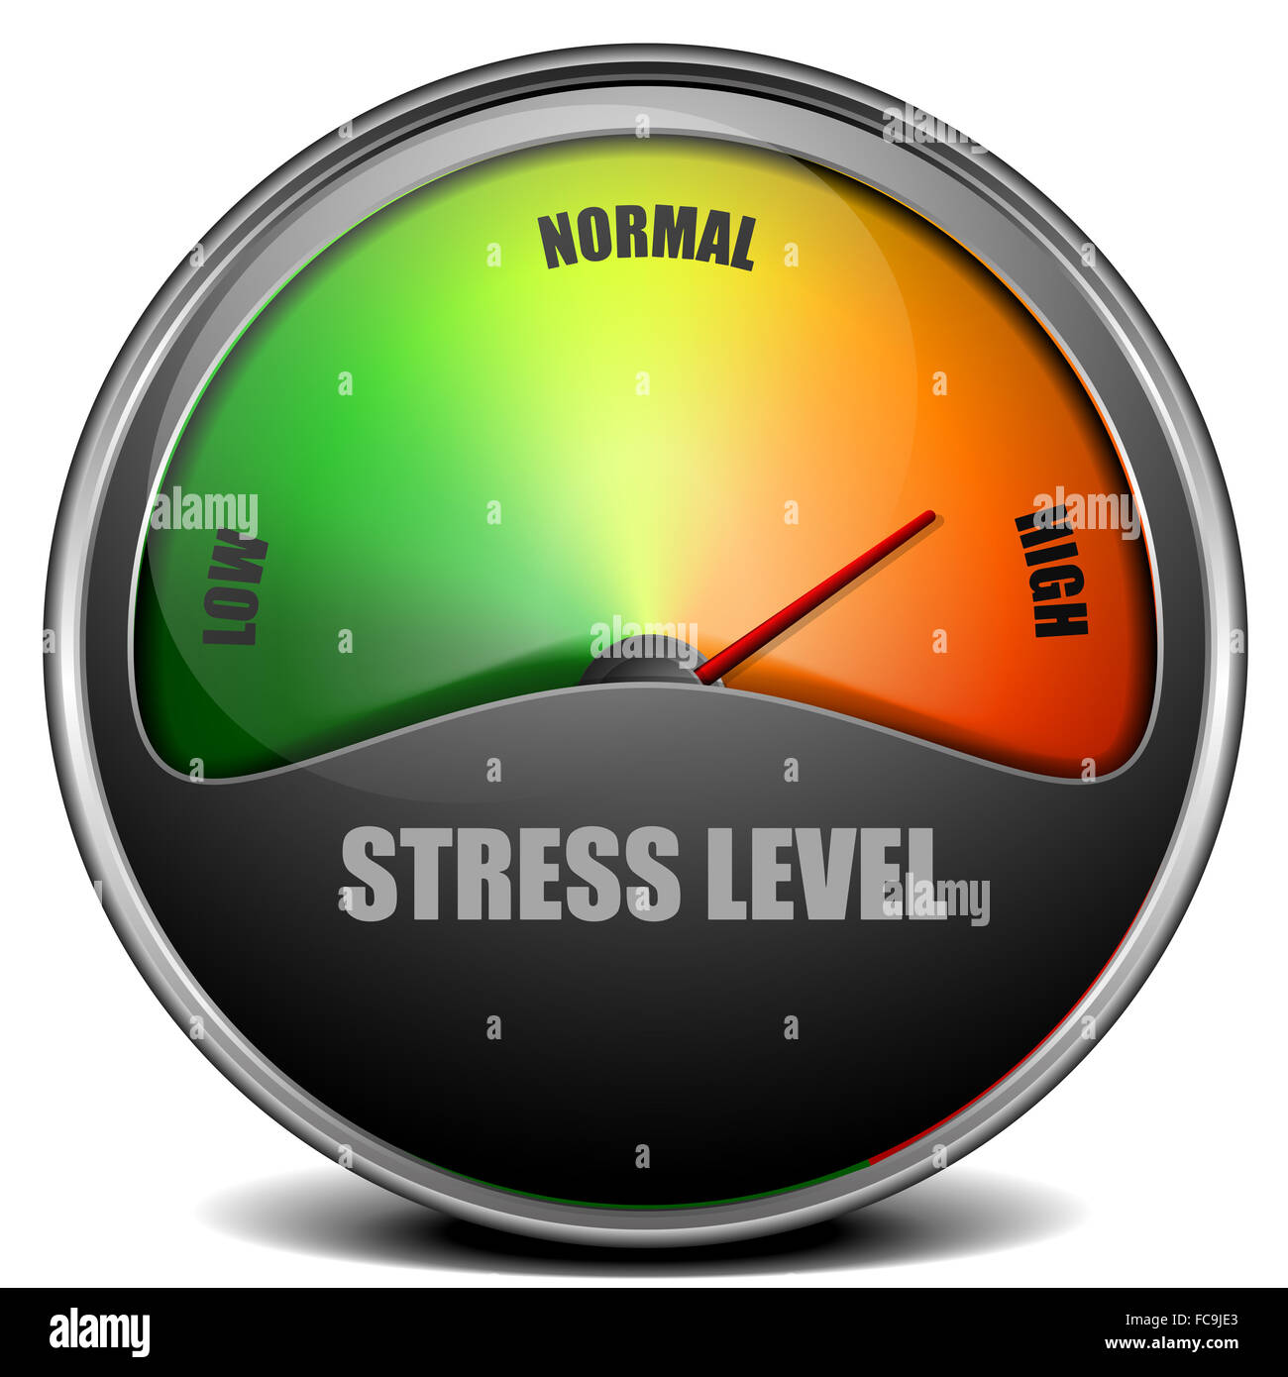
Introduction
Covid 19 affect all over the world. It also affect education system.
Teaching had to change into online mode.
This project aims to analyze the stress level of Teachers during covid 19
It analyze the school teachers in India
Data collected from Google form survey.
Based on certain factors analyze data and how it affect stress level. And also it classify the level of stress using various model.

Slide 3
Dataset
Dataset contain 17 features
sl no
Gender
Age
You are teaching in Which category of school
You are from which state
You teach in which Board
Which level you are teaching
Which platform do you use for delivering your content
Level of preparation required for online teaching compared to offline teaching
Your level of technical expertise
Effectiveness of Online teaching-learning Process compared to Classroom Teaching
Attitude of Students towards Online Classes
Performance of students in exams based on online classes
How do you rate your stress level in managing the online classes and video preparation compared to classroom teaching Attentiveness of students during online session compared to classroom sessions
Your satisfaction level taking online classes compared to offline classes’
Any other Suggestions or Information you want to give

Slide 4
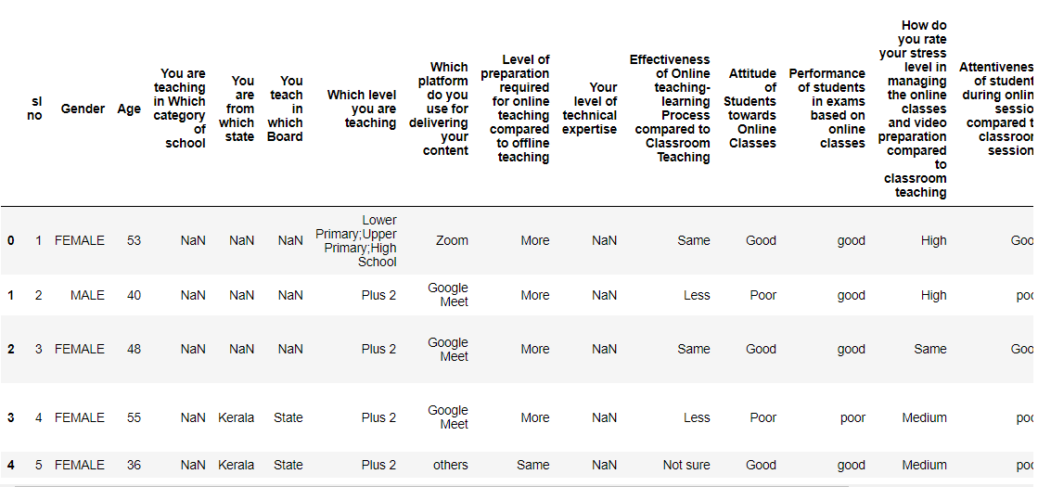
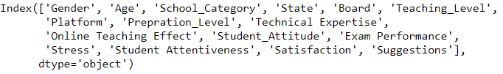
Dataset contain 189 observation
All the variables are categorical
After renaming the columns

Slide 5
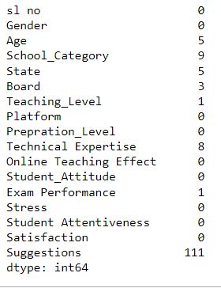
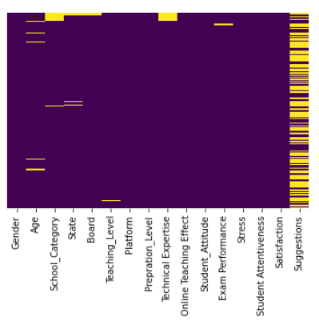
Column ‘Age’ contain string value other than number. So replaced column with null value
Most of the column contain null value.
Replace null value with mode

Slide 6
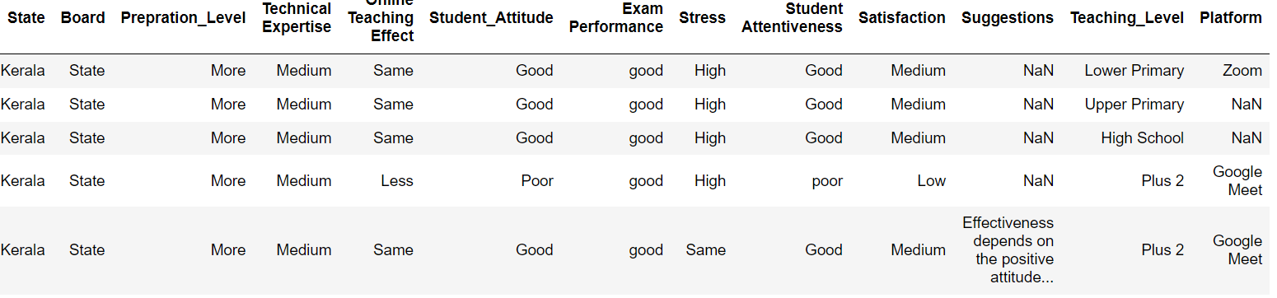
Age is a categorical variable, so age is converted into numerical variable
Teaching Level and Platform contain multi value in a column. Using split function multi column changed
After using split function number of rows changed to 269
Categorical values are changed into numerical using replace function and get_dummies function.

Slide 7
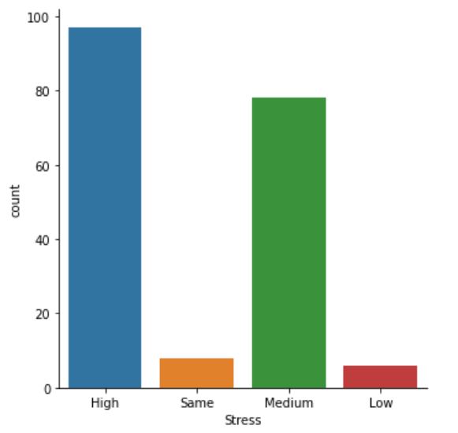
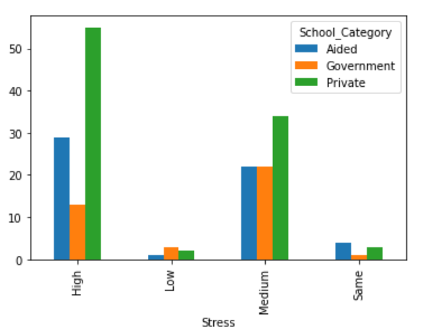
Visualization

Slide 8
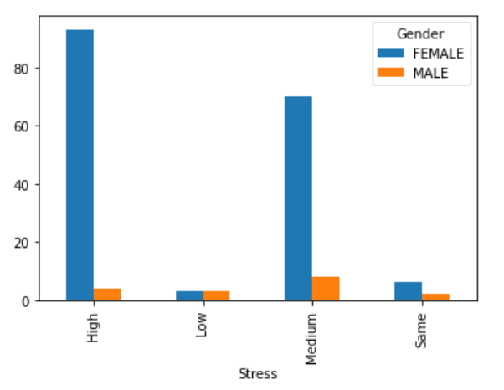
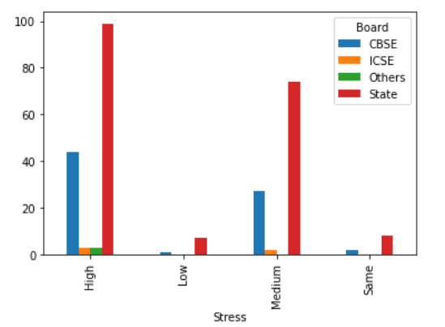

Slide 9
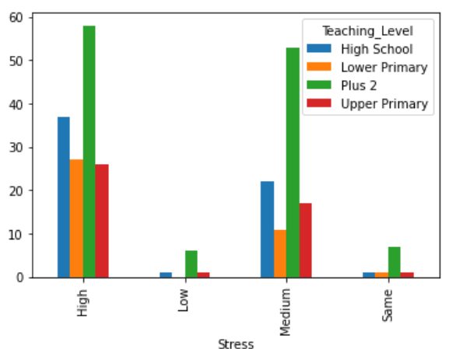
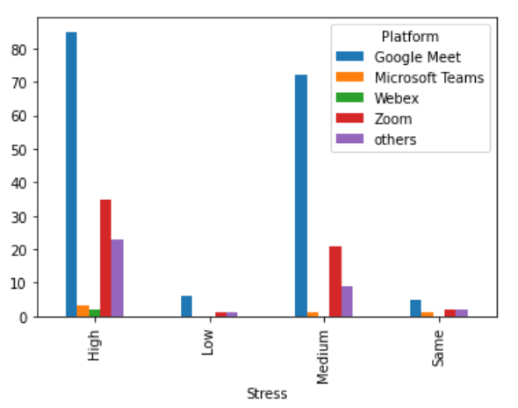

Slide 10
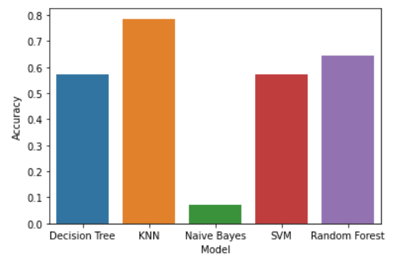
Models
Decision Tree
Naïve Bayes
K-Nearest Neighbor
Random Forest
Support Vector Machines

Slide 11
Conclusion
Out of 189 Teachers 97 have highest stress
Private school Teachers have stress level is high
Female Teachers have more stress than male
Those who are teaching in the state board has highest stress
Plus 2 Teachers has highest stress
Those who use Google meet as a platform for teaching has the highest stress
From 5 model KNN has the highest accuracy
There are many problem regarding this dataset, it is a small dataset, in that many field has missing value. And also most of the value get is from Kerala so other state could not analyze.

Slide 12


